Slide 1
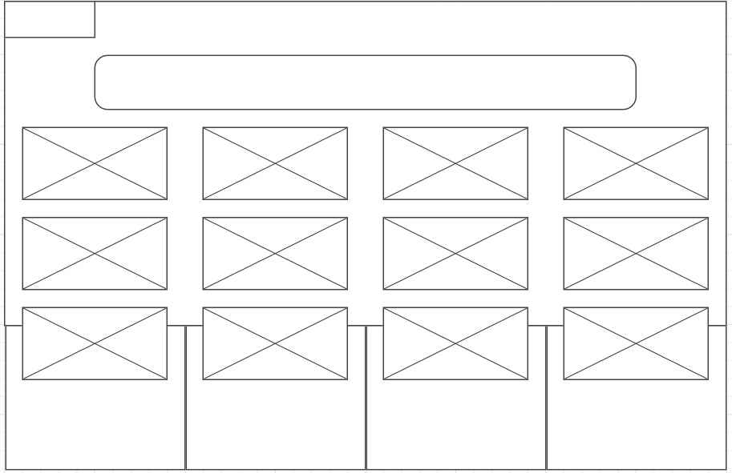
Nav
Header
Article
Article
Article
Article
Wrapper
Article
Article
Article
Article
Section
Article
Article
Article
Article

Slide 2
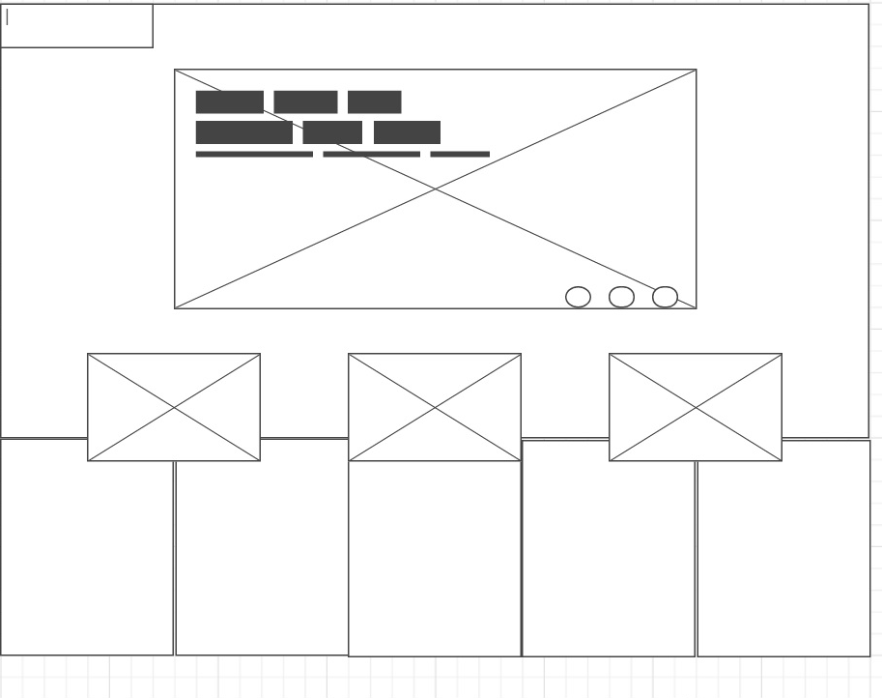
Nav
Header
Wrapper
Article
Article
Article
Section

